Slide 1
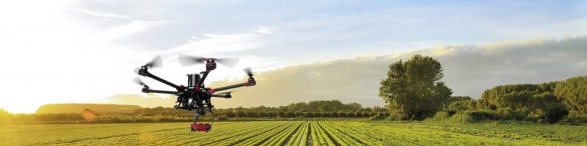
Precision Farming
Team 5
Notes:
Hello and good day to everyone. Today, our group would like to present
our precision farming system.
We know that agriculture is a key source for food over the world.
But recently climate change and some other variable might be
potential to harm on worlds’ agriculture.
One of the consequences might happen is the growth of unwanted plant on the
field such as parasite and weed. Therefore, precision farming system
play a big role to help farmer to take a good care of the field.
Abis la zaf

Slide 2
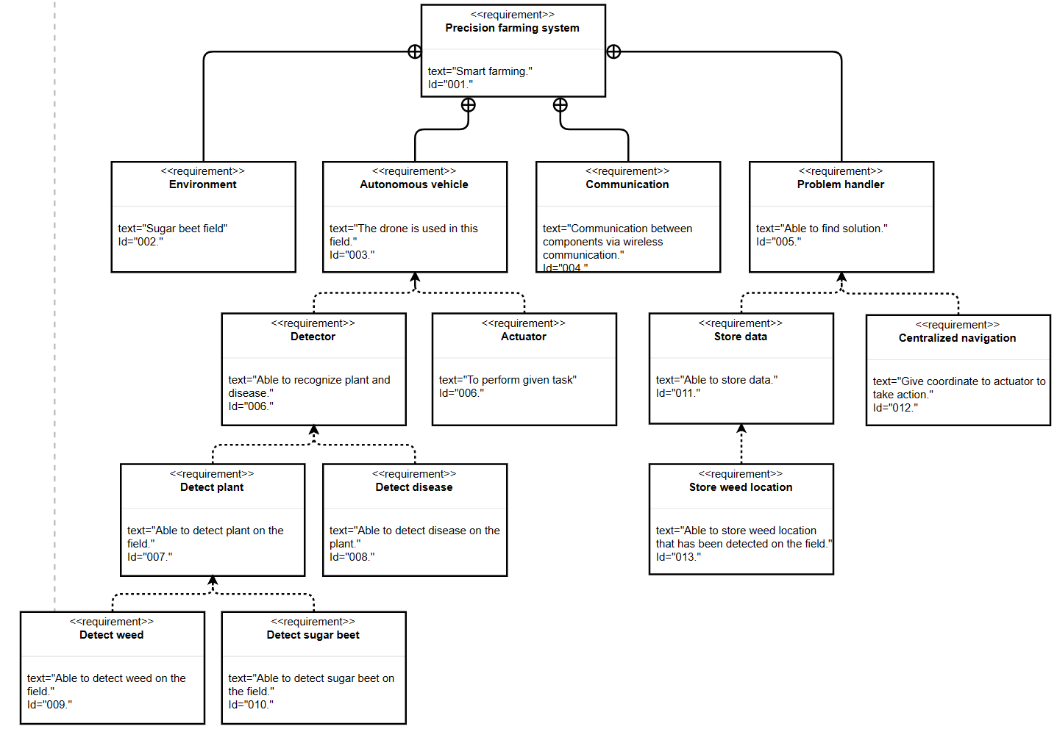
Introduction
Goals
Smart farming
Build model to detect weed on sugar beet field.
Model high accuracy.
Requirements
Notes:
this problem lead to our goals to help solve the problem by build a high
accuray model that able to detect any kind of plant on the field.
But in our case, we are focusing on sugar beet and weed detection.
As what we hv discuss among group members, our first step is to create
a requirement diagram that fullfil
all of requirement of our precision system.
As you guy can see in the slide, our requirement for
precision farming system are ….

Slide 3
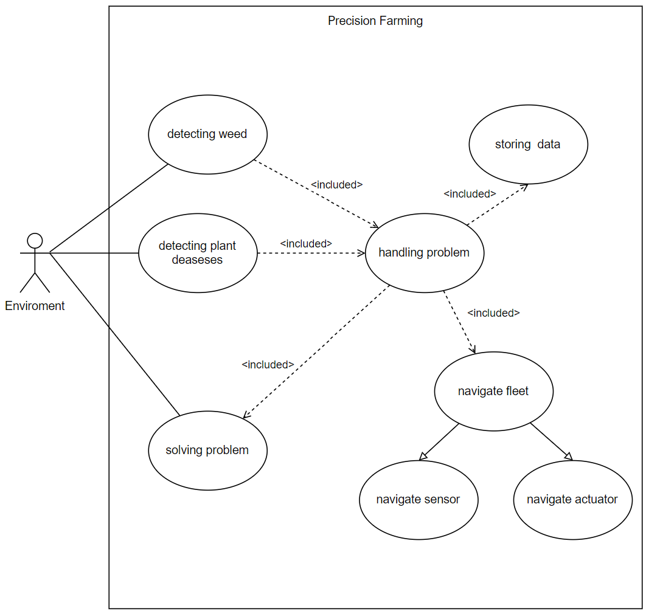
Design
Use case diagram precision farming system.
Notes:
Moving on to the next slide, Based on the requirement diagram, we have
further refine our diagram by creating
a use case diagram to describe context of our system.
Now my friend kimi will explain about the system architecture and tappaal model to visualize our scenario.

Slide 4
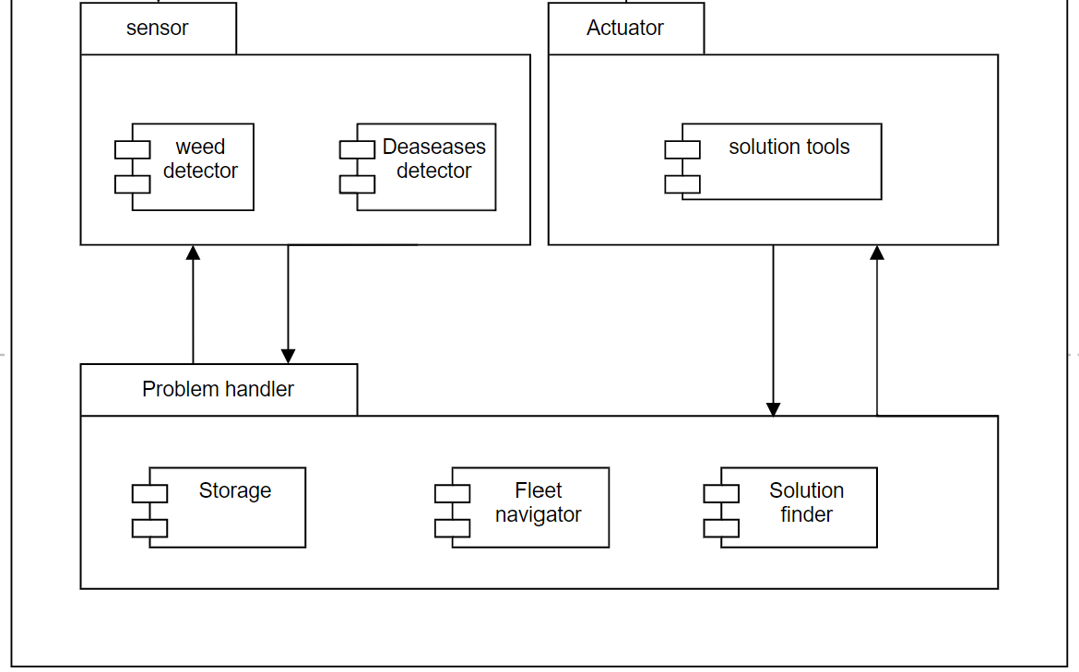
Design
System Architecture
A conceptual model that defines the structure and views of a system
Consist of system components and the sub-systems

Slide 5
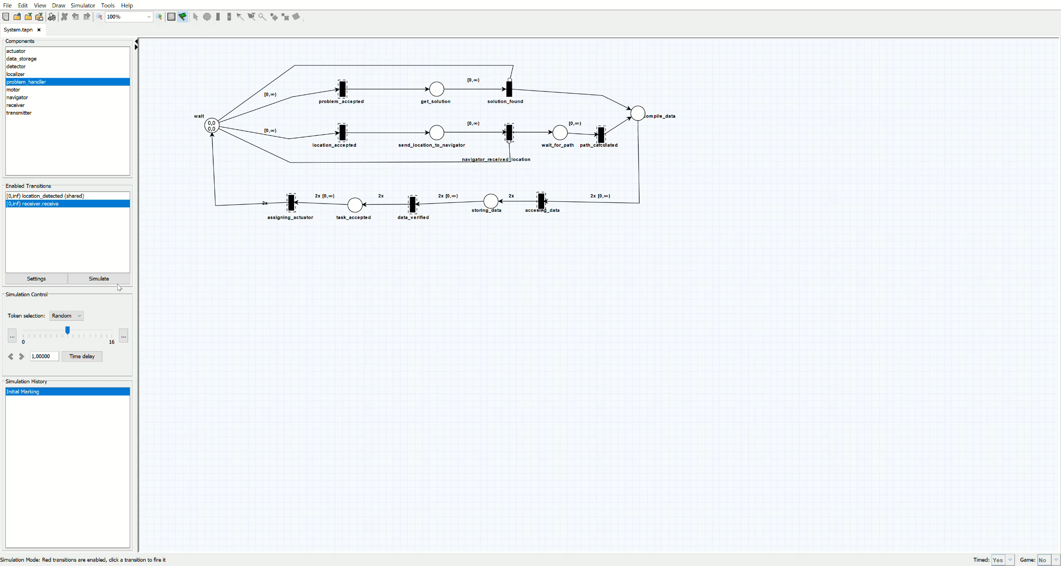
TAPAAL Simulation

Slide 6
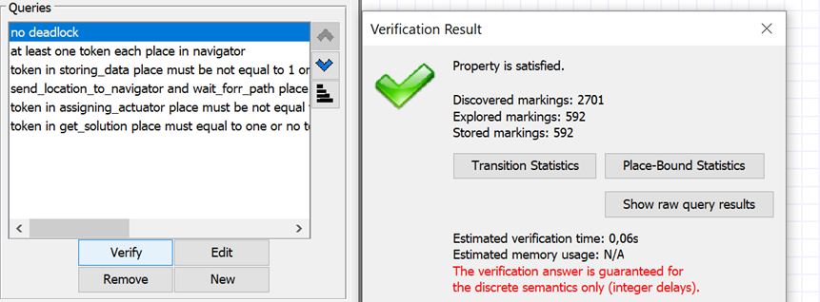
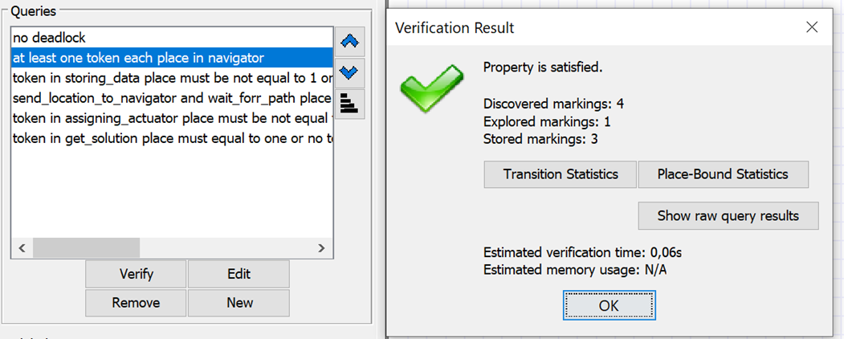
TAPAAL Verification
Verification is important because to ensure that the implementation of the model is correct
During verification, the model is tested to find and fix errors in the implementation of the model

Slide 7
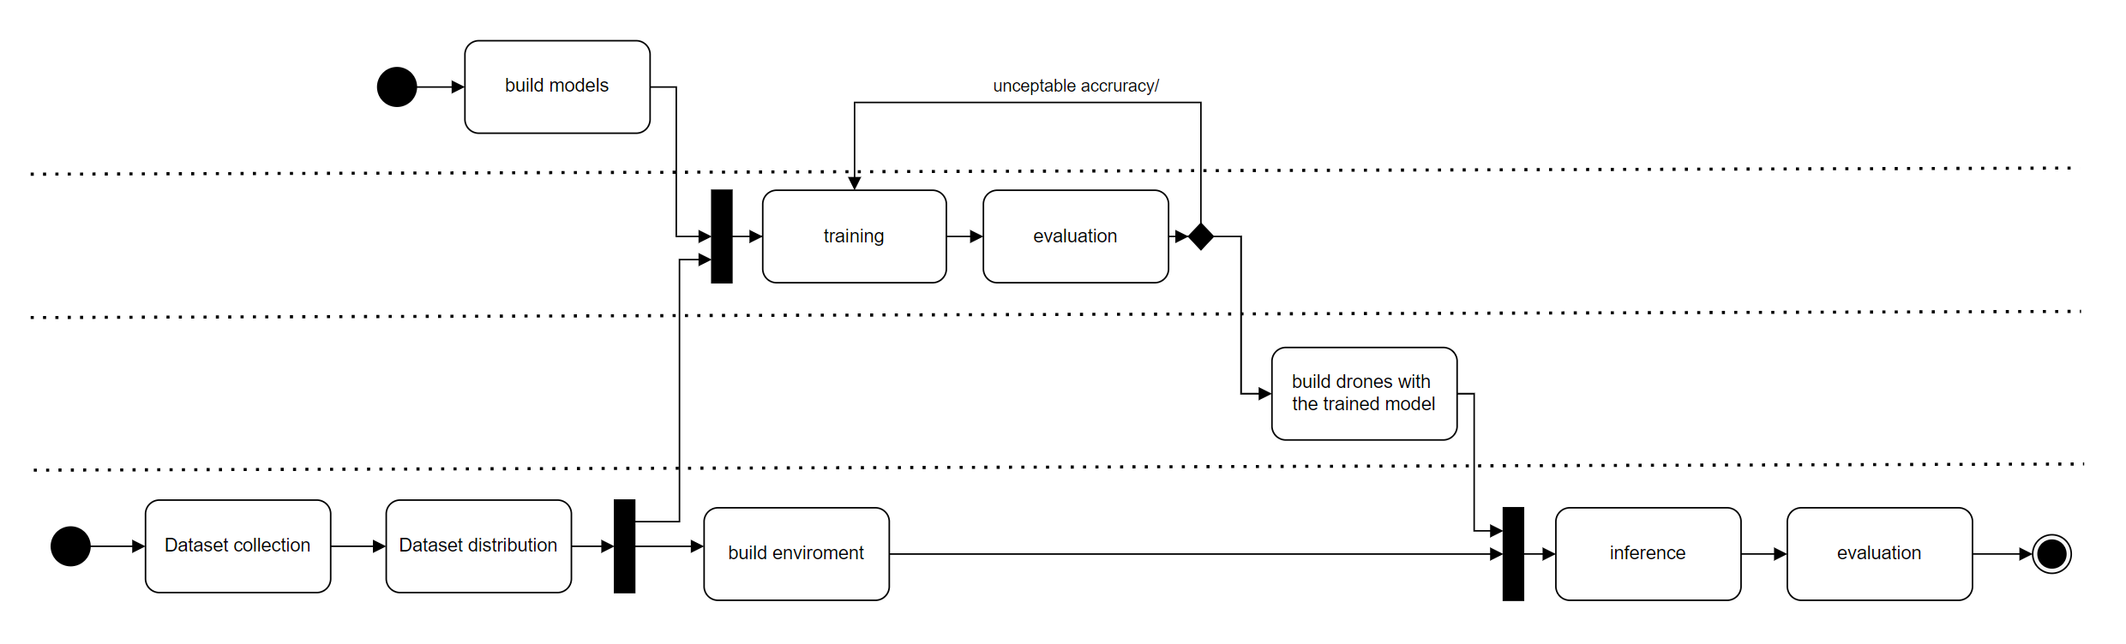
Implementation workflow
Build trained model
Simulation
Notes:
For the implementation, we first start with gathering the dataset and set of network And then we train them and compare the result to choose the best one After that, the model will be used in our simulation platform which consist of a virtual drone and field

Slide 8




Implementation of model
Model
Environment
Data
Data collection
HSHL
Kaggel
Mendelay data
Total Classes
121
Data distribution
80 training
20 validation
Model
Training
Epoch 5, 10, (7)
Learning rate
learn.lr_find()
Inference on virtual field
Drone
Best model
Vgg19
Field
Sugar beet field with weed ( other plant )
Resnet18 | Vgg19
Resnet34 | Vgg16
Restnet50 | Squeeznet
Alexnet | Densenet201
Model | Training Accuracy
Resnet18 | 0.776524
Resnet34 | 0.858555
Resnet50 | 0.874077
Alexnet | 0.738265
Vgg19 | 0.864439
Squeezenet | 0.798598
Densenet201 | 0.903868
Notes:
Now l will explain the detail of each step. For our dataset, we get them from HSHL, kaggel, and Mendeley data In total, we have around 16000 images. Where 80% of them is for training and 20% for validation After that, we list all the models that we want to compare as listed in this table and proceed to the training phase In the training phase, we did some optimization. We try to find the best number of epochs for each model to have higher accuracy. For instance, we use 7 epoch to train vgg19 We also tune the learning rate with lear.find() function And the result for each model I listed here where the best one is densenet201 with 0.93 accuracy After that, we proceed with the simulation that involves a virtual field which is a sugar beet field and a drone that implements our trained model, vgg19 You guys must be curious why we choose vgg19 instead of densenet201.but dont worry, You guys will get the answer by the end of this presentation. Next, ammar will explain more about the simulation

Slide 9

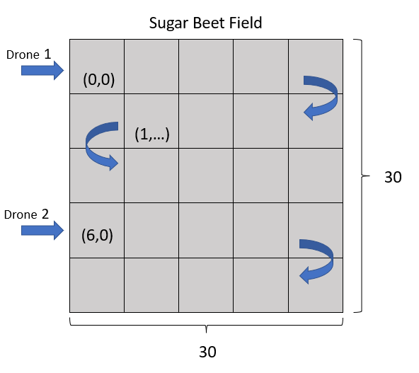
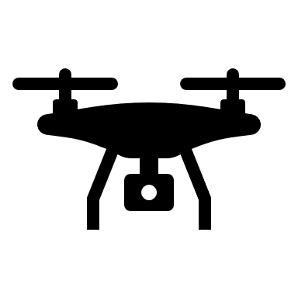

Simulation
Create field
30x30 array
Image data is placed randomly in the array
Drone
5 drones assigned to 6 rows
Movement of each is like snake pattern
Task
Read the image and detect weed/sugar_beet
Collect weed location
For each weed detected, they are compiled in master list
Notes:
Hello everyone,
- Follow closely format of the competition
- First we created an array of 30rows and 30colomns to represent our sugar beet field
- The data is then placed randomly in the field (Sugar_beet/Weed)
- We deployed 5 drones each of which are assigned to 6 rows respectively
- The movement for each drone is like a snake like pattern
- Each will read the images and detect weed
-If its a weed, the name, location will be compiled in a master list.

Slide 10
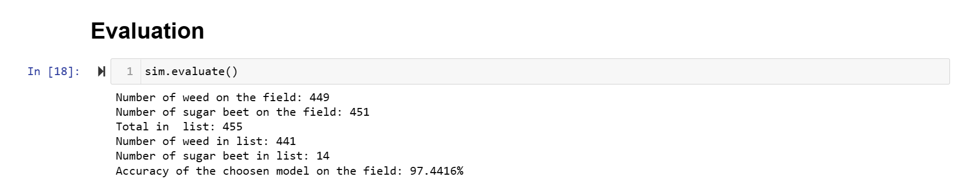
Evaluation
Result on field ( include comparison/simulation)
std_Simulation - Jupyter Notebook
Model | Training Accuracy | Original weed/ sugar | Considered weed (weed, sugar) | Actual accuracy
Resnet18 | 0.776524 | 449/450 | (442, 172) | 80.0889
Resnet34 | 0.858555 | 449/450 | (442, 251) | 71.3014
Resnet50 | 0.874077 | 446/453 | (444, 70) | 91.8888
Alexnet | 0.738265 | 449/450 | (437, 151) | 81.7777
Vgg19 | 0.864439 | 449/450 | (443,25) | 97.4416
Squeezenet | 0.798598 | 449/450 | (444, 215) | 75.5283
Densenet201 | 0.903868 | 449/450 | (447, 52) | 93.8888
Notes:
As you can see that these are the we uses different models to find the actual accuracy

Slide 11
Conclusion
With the help of DL, in field computer vision, we can improve precision farming
With advance modeling method (TAPPAL), we can build safe system in shorter time
We choose Vgg19 as its has most accuracy.

Slide 12
Backup Slides

Slide 13
classes
'aeonium', 'agapanthus', 'almond', 'aloe_vera', 'alstonia_scholaris', 'amaryllis_flower', 'anemone_flower', 'arjun', 'asparagus', 'aster', 'baby_breath_flower', 'bael', 'banana', 'basil', 'black_grass', 'black_rose_flower', 'blue_chicory', 'blue_vervain', 'bougainvillea_flower', 'bromeliad', 'buttercup_flower', 'calendula_flower', 'canna', 'cannabis_flower', 'carex', 'cattails', 'charlock', 'chickweed', 'chinar', 'cleavers', 'coconut', 'coconut_tree', 'common_chickweed', 'common_wheat', 'cone_flower', 'coronation_gold', 'crimson_clover', 'crocus_blue', 'daffodil_flower', 'daisy', 'daisy_fleabane', 'dandelion', 'datura_flower', 'delonix_regia_flower', 'downy_yellow_violet', 'elderberry_flower', 'fat_hen', 'fireweed_flower', 'forget_me_not', 'gauva', 'golden_champa_flower', 'harebell_flower', 'hibiscus_flower', 'hyacinth_flower', 'iris_flower', 'jamun', 'jasmine_flower', 'jatropha', 'joe_pye_weed', 'jonquil_flower', 'knapweed', 'larkspur_flower', 'lily_flower', 'loose_silky_bent', 'lotus_flower', 'madagascar_periwinkle', 'maize', 'mallow_flower', 'mango', 'marigold_flower', 'milk_thistle_flower', 'mini_carnation_purple', 'mullein_flower_yellow', 'mushroom', 'mustard', 'narcissistic_flower', 'oleander_flower', 'orchid_flower', 'palash_flower', 'parlor_palm', 'pemon', 'pickerelweed_flower', 'poinsettia_flower', 'pomegranate', 'pompon_flower', 'pongamia_pinnata', 'prickly_pear_cactus', 'primrose_blue', 'protea', 'purple_deadnettle_flower', 'queen_anne_s_lace_flower', 'ranunculus_flower', 'red-hot_poker', 'red_clover', 'red_rose', 'rose_hips', 'saffron_flower', 'scentless_mayweed', 'sedum_purple', 'shepherds_purse', 'small_flowered_cranesbill', 'solidago_flower', 'st_john', 'statice_flower', 'sugar_beet', 'sunflower', 'teasel_flower', 'touch_me_not_flower', 'trachelium_flower', 'tuberose_flower', 'tulip_flower', 'vervain_mallow_flower', 'viola_flower', 'waxflower', 'white_yarrow', 'wild_bee_balm_flowers', 'wild_grape_vine', 'wild_leek', 'yellow_sow_thistle', 'yucca', 'zinnia_flower_red'

Slide 14
notebook
Sugar beet detection/
training_vgg19_bn - Jupyter Notebook
Inference-vgg19_bn - Jupyter Notebook
std_Simulation - Jupyter Notebook

Slide 15
Activity diagram

Slide 16
Sequence diagram

Slide 17
